Slide 1
CHEMISTRY Jeopardy
Category 1 | Category 2 | Category 3 | Category 4 | Category 5
10 | 10 | 10 | 10 | 10
20 | 20 | 20 | 20 | 20
30 | 30 | 30 | 30 | 30
40 | 40 | 40 | 40 | 40
50 | 50 | 50 | 50 | 50

Slide 2
Which four elements make up over 95% of living matter?
CHON!
Notes:
Category 1 - 10

Slide 3
How do isotopes of the same
element differ from eachother?
number of neutrons
OR
mass number
Notes:
Category 1 - 20

Slide 4
DAILY DOUBLE
What two particles in an atom both
have a mass of one Dalton?
protons and neutrons

Slide 5
The number of protons in an atom is also called
Atomic number

Slide 6
What must you add to get the atomic mass?
Protons and neutrons

Slide 7
Atoms whose outer energy levels have
8 electrons tend to be what?
nonreactive, inert, stable

Slide 8
Compounds created by covalent bond
are called
molecules

Slide 9
If the element Jazzonium is more
electronegative than the element
Brownian, then which atom
In a molecule of JaBw₃ has a positive charge?
Is it slight or strong?
Brownian. slight

Slide 10
What results from an UNEVEN
SHARING of electrons?
(be specific)
Polar covalent bond

Slide 11
What causes a polar covalent bond
between two different atoms?
(use a chemistry term)
When one atom is more electronegative than the other

Slide 12
What is a bond formed from the
attraction of atoms who have
transferred electrons?
Ionic bond

Slide 13
What most DIRECTLY, specifically
causes water
Molecules to be cohesive?
Hydrogen bonds

Slide 14
What interaction can result from the
Weak attraction of the nucleus of one
molecule and the electrons of another?
Van der Waals

Slide 15
What is the state when the forward
and reverse Reactions continue at an equal rate
With no effect on the concentrations of
reactants and products?
Chemical equilibrium

Slide 16
In one water molecule, two H atoms are
bonded to one O atom by
Covalent bond

Slide 17
When ice cools a drink, the kinetic energy of the drink increases or decreases?
decreases

Slide 18
Peptide, esther, etc…are all what
Types of bonds?
covalent

Slide 19
Is heat released or absorbed when
Hydrogen bonds are formed?
released

Slide 20
What property of water explains why large ears help remove heat?
High heat of vaporization

Slide 21
At what temperature is water most dense?
4 degrees Celsius

Slide 22
What type of bond does Carbon tend to
Form?
Covalent bonds

Slide 23
Why are hydrocarbons insoluble in water?
Mostly non polar covalent bonds (C-H)

Slide 24
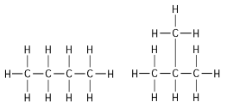
Structural isomers

Slide 25
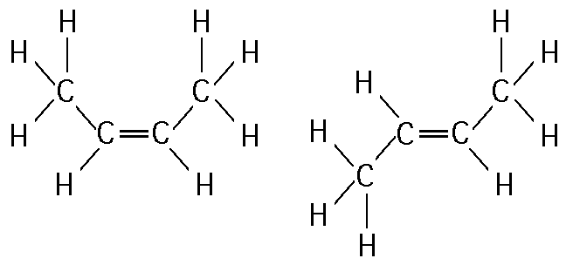
What
Geometric isomers

Slide 26
Molecules that are mirror images of eachother
enantiomers

Slide 27
For clarity….
The breaking of H bonds absorbs heat…thus sweat evaporating takes away your body heat.
The forming of H bonds releases heat, thus ice on top of lake can release heat below.
Make sense????
High specific heat because of the H bonds releasing and absorbing energy (forming when condensing, breaking when vaporizing)
Ice less dense due to organization of H bonds spacing out.

